Slide 1
A Branded Entertainment Marketing Opportunity
Hollalujah Enterprises, Inc.
Phone: (678)612-4322
Connect With Us & Let Us Go To Work For Your Brand!
Sponsorships@Hollalujah.com

Slide 2
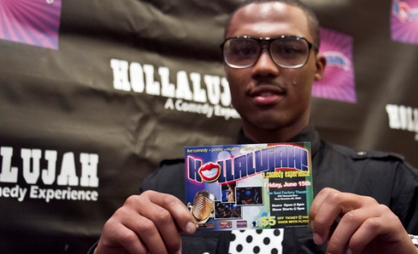
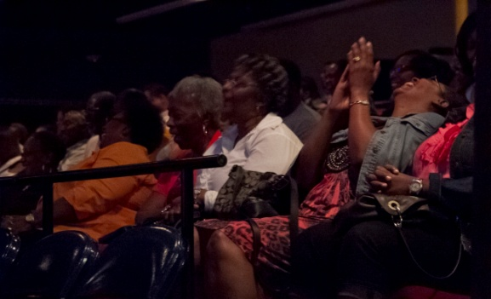
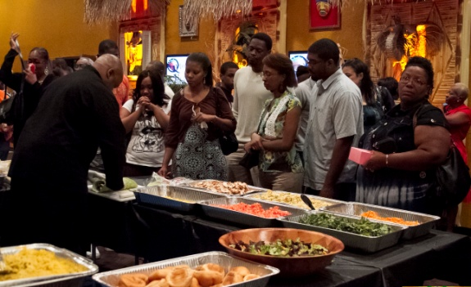
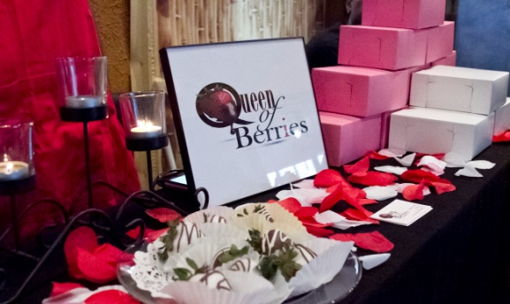
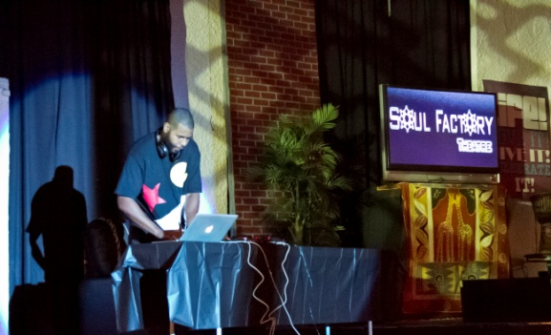
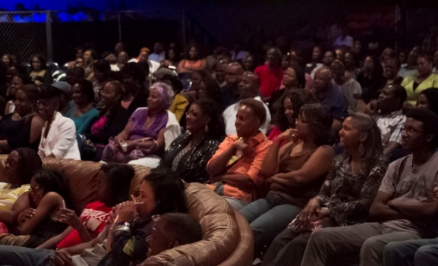
Hollalujah: A Comedy Experience
If you’re marketing your business in the Atlanta Metropolitan Area, you already know how essential the faith-based market is to your success. But until you’ve been introduced to Hollalujah as a sponsor, you’ll have no idea what an amazing marketing platform this is for generating new relationships with consumers, sampling products or driving traffic to your digital channels.
Nearly 1,000 consumers pack the parking lot at Peace Baptist Church in Decatur, Georgia, pay the admission and pack the auditorium for an evening of wholesome live entertainment, food, and social engagement featuring some of the most talented artists in the nation.
Hollalujah is Saturday Night Live meets the Kings of Comedy and Showtime at the Apollo—without all the negative attributes that distinguish those entertainment brands within their genres.
Hollalujah Enterprises, Inc.
Phone: (678)612-4322 Sponsorships@Hollalujah.com

Slide 3
Hollalujah: Up Close & Personal
Core Demographic
Hollalujah Enterprises, Inc.
Phone: (678)612-4322 Sponsorships@Hollalujah.com

Slide 4
Hollalujah: Up Close & Personal
Core Demographic
Hollalujah Enterprises, Inc.
Phone: (678)612-4322 Sponsorships@Hollalujah.com

Slide 5
Core Demographic
Education 61% Undergrad Degree or Higher, 23% College Ed
Household Income 58% $20k-$49k, 23% $50k+
Employment 66% F/T, 22% P/T
Hollalujah: Up Close & Personal
Core Demographic
Hollalujah Enterprises, Inc.
Phone: (678)612-4322 Sponsorships@Hollalujah.com

Slide 6
Core Demographic
Education 61% Undergrad Degree or Higher, 3% College Ed
Household Income 38% $20k-$49k, 62% $50k+
Employment 66% F/T, 22% P/T
Hollalujah: Up Close & Personal
Core Demographic
Hollalujah Enterprises, Inc. 5881 Strathmoor Manor Circle Lithonia, GA 30058
Phone: (678)612-4322 Sponsorships@Hollalujah.com

Slide 7
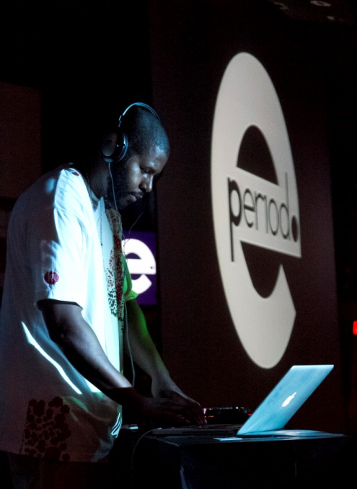
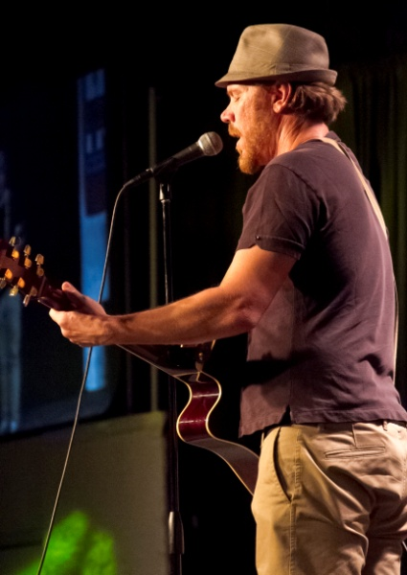
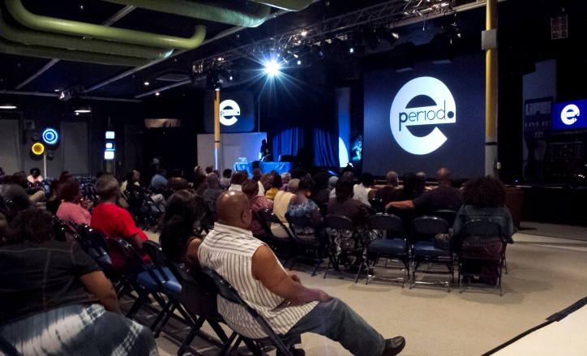
Hollalujah: Where Creativity Meets Authenticity & Value
With its legions of concerts, live theater, sports events, social events and mega-church events, Atlanta is easily one of the most competitive live entertainment markets in America. Yet, the creators of Hollalujah—Atlanta’s most popular faith-based entertainment platform—have created a unique concept that has attracted demand from other cities and that many have already tapped as a potential ready-made TV hit series. In one night, guests enjoy elements of live music, comedy, poetry, vocalists, and even dance—all on one incredible stage!
Atlanta represents a multi-million dollar faith-based marketplace that rewards the companies that are perceived to be supportive of their lifestyle with preference and loyalty. Hollalujah provides a creatively produced evening of wholesome entertainment that includes live musical performances, spoken word and rib-splitting comedy from some of the most talented artists in the nation. Your brand integration with Hollalujah provides your company access to over 60,000 consumers each month via our media network and nearly 1,000 personal touch opportunities at Peace Baptist Church!
Hollalujah Enterprises, Inc.
Phone: (678)612-4322 Sponsorships@Hollalujah.com

Slide 8
Hollalujah: How We Connect the Dots
"Many African Americans consider faith an integral part of their lives. These are people that fit our (Ford Motor Company) target demographic really well in terms of income, age and lifestyle."
Marc Perry,
Multicultural Marketing Manager, Uniworld Group
When you make a marketing investment, you want a partner who’s willing to understand how you measure success and how your brand needs to be presented to the target. Our team of brand ambassadors specialize in hearing you clearly and in executing flawlessly against your expectations.
Among our arsenal of marketing tools are:
An Opt-In Database of over 60,000 consumers who look forward to hearing what’s new through limited broadcast emails each month
In-House Video Capabilities for the production of customized messaging and the Hollalujah Report—a video promo taped live each show featuring fans, sponsors and out-takes of the show, then served to social media and email
Presenting Sponsorship where one (1) exclusive sponsor can attach its brand to ours in a way that garners consideration, trial and brand preference
Promotional Partners where brands can collaborate with our team to create unique experiential opportunities for our guests to win prizes provided by the partner
Product Placement Sponsors where sponsor brands are strategically placed throughout the venue and fans are driven to interact through a traditional and social media prompts that lead to sampling
Hollalujah Roadshow where we leverage our relationships with our fans and bring consumers to your business for an exclusive event designed specifically for your brand. Ideal for retail, car dealers, real estate and restaurants!
Hollalujah Enterprises, Inc.
Phone: (678)612-4322 Sponsorships@Hollalujah.com

Slide 9
Hollalujah: About the Producers
EPeriod, LLC has been wowing crowds and producing incredible events for the past
twelve years. In addition to writing and producing poetry and jazz shows, founder E.
Christopher Cornell has a resume that includes appearances on MTV Road Rules 11:
Campus Crawl with Grammy Award-winning group Outkast; appearances on Atlanta based
V-103 as a featured entertainer; accolades in Upscale Magazine, the L.A. Times,
the Atlanta Business Chronicle and Rolling Out Magazine; performances on Robert
Townsend’s Spoken on Black Family Channel and BET’s Lyric Café; youth empowerment
by hosting teen open mic events, writing workshops and through his non-profit
organization, Project A.R.M.; opening performances for national recording artists
including Will Downing, Angie Stone and Musiq Soulchild; Executive Producer/Artistic
Director of She Speaks; entertainment booking for universities, churches, community
centers and conventions; public speaking instructor at Spelman College; Lead Business
Communication instructor at Year Up; highly successful events including production of
DeKalb Family Fun Day with Former CEO Lee May
Corwin “C-Dawg” Oglesby Corwin O., or to his friends and fans "C-Dawg", is well
decorated and respected comedy veteran. Corwin O.'s silly, care-free style of comedy
is as fun to watch as it is to hear. He draws you into his hilarious comedy world with
his even keel comedic timing and vivid story telling with a flair for free-style that hooks
audiences and keeps them eagerly wondering what he may do next! Corwin O. is a
native of Atlanta, GA and incorporates southern style humor in his material. Corwin O.
is also a key player in the improvisational troupe "The Blacktop Circus", and is a regular
host of The Uptown Comedy Club in Atlanta. Corwin O. has shared the stage with some
of the best and brightest in comedy, including Chris Tucker, Jamie Foxx, Steve Harvey,
and Monique! He continues to tour comedy Clubs, Colleges, and is nationally
recognized with credits including BET, Army International Tour, and major radio
markets. Corwin O. is a definite must see! He is funny, powerful, lovable, silly and
commanding as a southern preacher!!! The world is his pulpit.
Hollalujah Enterprises, Inc.
Phone: (678)612-4322 Sponsorships@Hollalujah.com

Slide 10
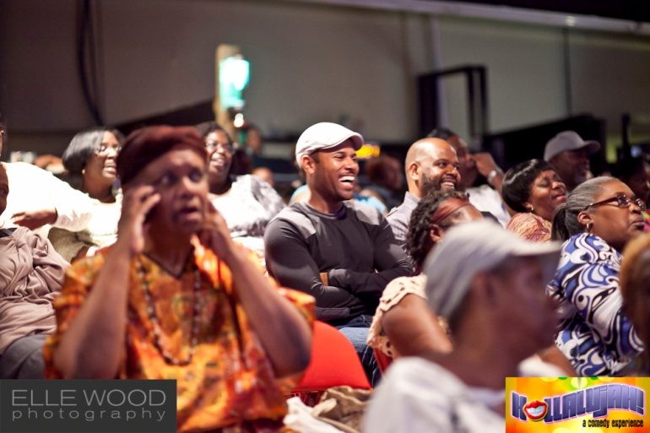
Hollalujah: Presenting Sponsor
Rights Fee: $12,500
Hollalujah: A Comedy Experience presented by NAME OF COMPANY provides you with a
family-centered entertainment showcase that reinforces positive attributes of your brand and
promotes brand preference among our fans over a twelve (12) month promotional campaign.
Your exclusive Presenting Sponsorship includes:
Logo inclusion in 60,000 broadcast emails per week promoting Hollalujah: A Comedy
Experience two weeks out from each month's event with link to your designated web
page
Customized brand integration within the script and marketing communication
designed to address your specific business objectives and ROI targets
Brand integration into on-stage give-away during each event
Brand collateral in seats in advance of each event
Rotating Banner Ad on the Hollalujah: A Comedy Experience website for duration of
sponsorship
Activation space in the Soul Factory lobby each month for engagement with consumers
before, during and after each event
Promotional mentions in paid radio ads on Praise 102.5 each month (and any associated radio) each event
Pop-Up Banners on Stage
Four (4) complementary admissions to Hollalujah: A Comedy Experience each event
Right of First Refusal on renewal of Presenting Sponsorship
Right of First Refusal on the extension of Hollalujah: A Comedy Experience as a web or
TV series
LIMIT ONE (1) PRESENTING SPONSOR

Slide 11
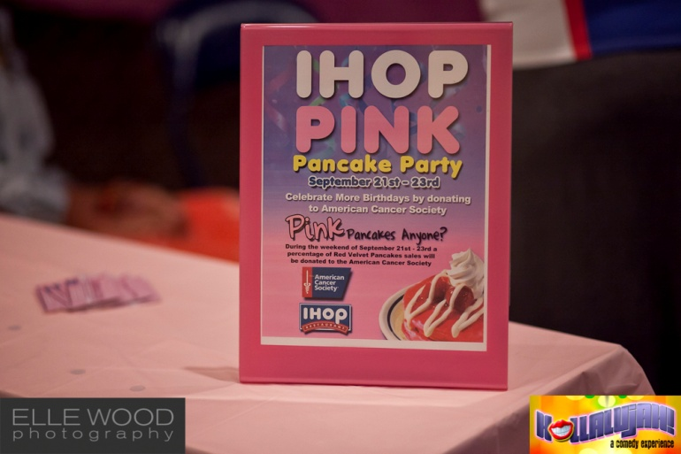
Hollalujah: Product Placement
Rights Fee: $750
Hollalujah: A Comedy Experience provides you with a family-centered entertainment showcase that allows your company to engage directly with consumers for less than .99 cents per consumer. In today’s media environment where consumers are bombarded with advertising messages, savvy marketers know that engaging consumers where they play is
one of the most effective marketing strategies available today!
Here’s how your Product Placement works:
The Hollalujah brand activation team will place your product in brand appropriate locations throughout the venue where guests will see them and play with them freely and without interference
Monitors throughout Peace Baptist Church (host venue for Hollalujah: A Comedy Experience) will show your product ad (without audio)—tying the on-premise exposure to the visuals in the ad. At the end of each ad, viewers will be directed to Tweet to a designated hash tag to get a free sample of your product or a valuable voucher to take home with them
Brand Logo with hyperlink on the Hollalujah website for thirty (30) days associated with your company’s sponsorship
LIMIT EIGHT (8) PRODUCT PLACEMENT SPONSORS PER MONTH

Slide 12
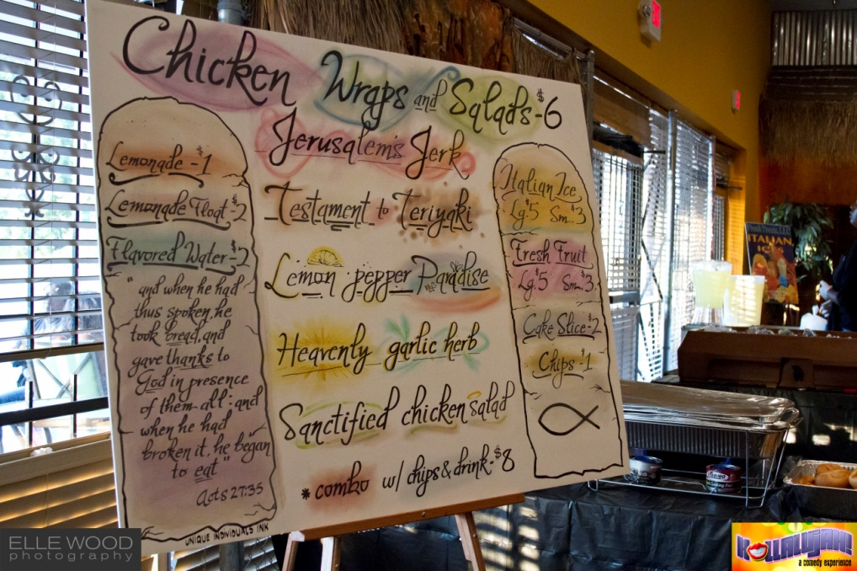
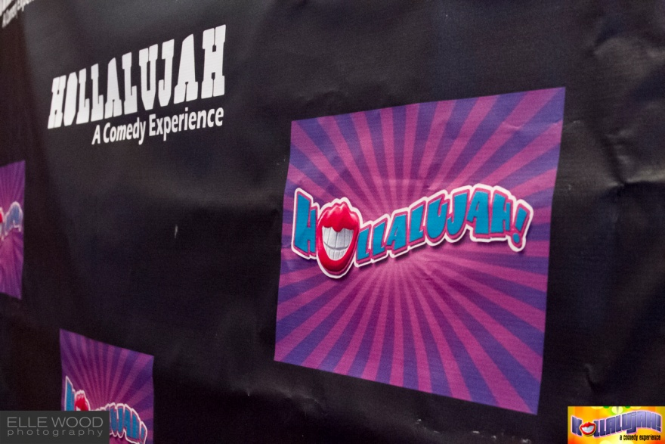
Hollalujah: Promotional Partner
Rights Fee: $525
Hollalujah: A Comedy Experience provides you with a family-centered entertainment showcase that introduces and reinforces your brand message while promoting brand preference among our fans throughout your engagement.
As a Promotional Partner your company receives:
Brand integration into on-stage give-away during each event
Product review video by Hollalujah brand marketing specialist recorded and served to over 30,000 members of the Hollalujah database
Brand Logo with hyperlink on the Hollalujah website for thirty (30) days associated with your company’s sponsorship
LIMIT FOUR (4) PROMOTIONAL PARTNERS PER MONTH

Slide 13
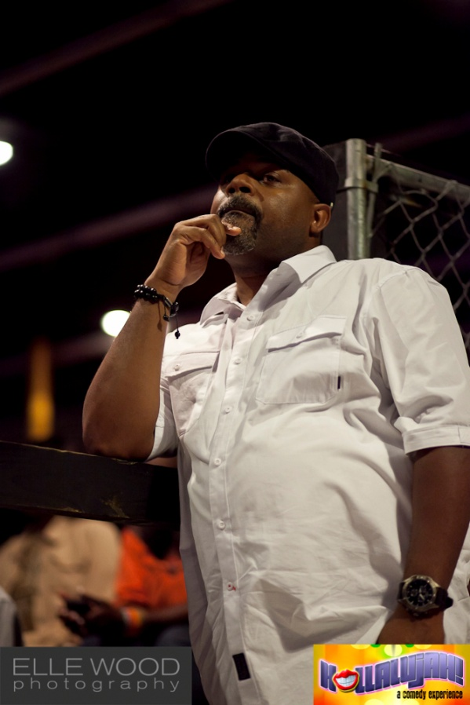
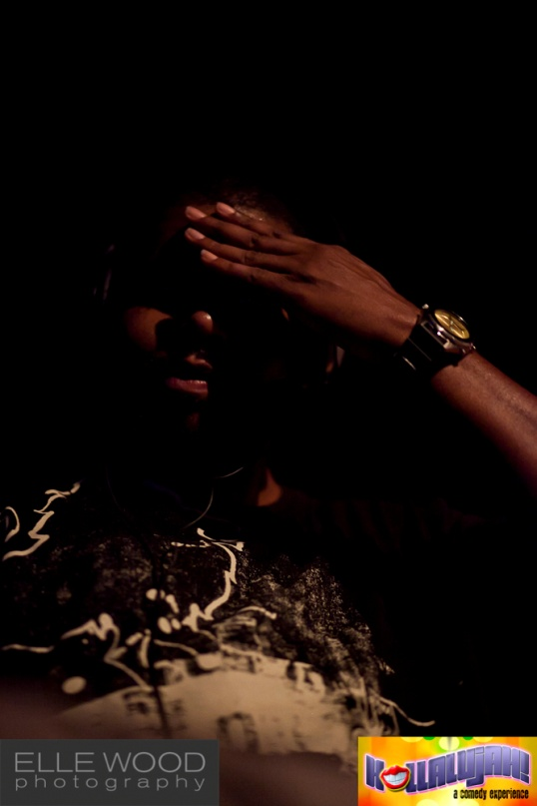
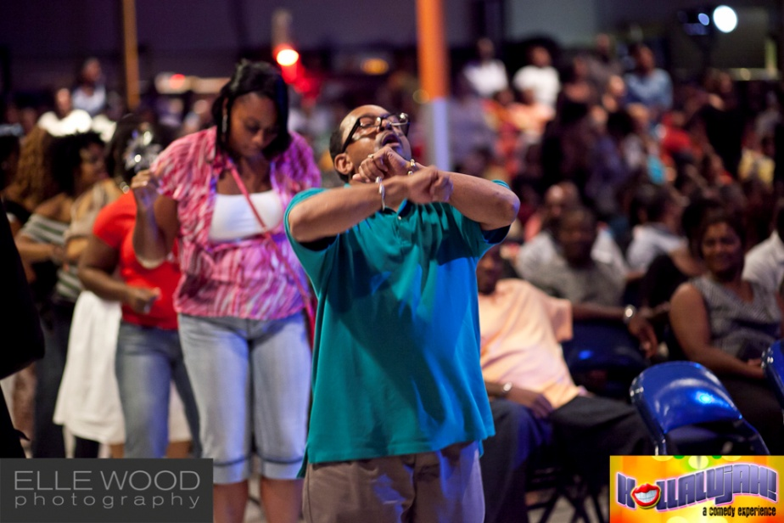
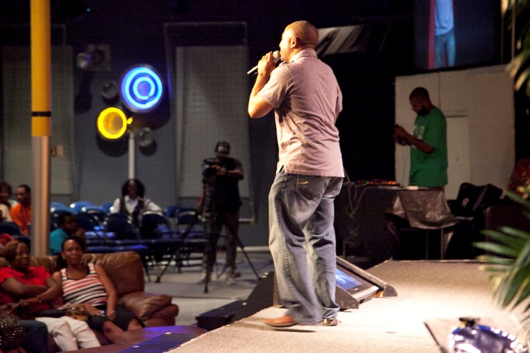
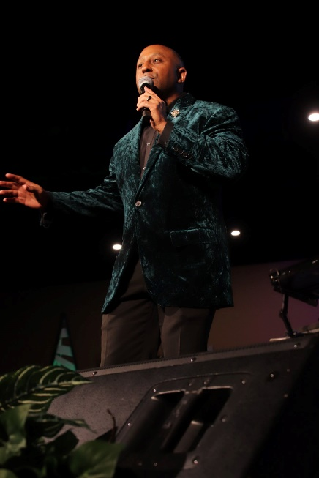
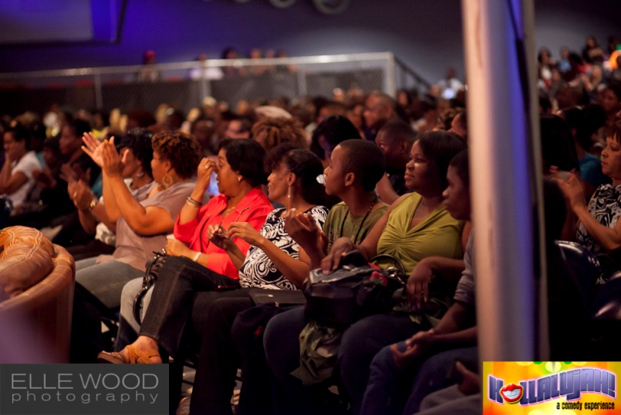
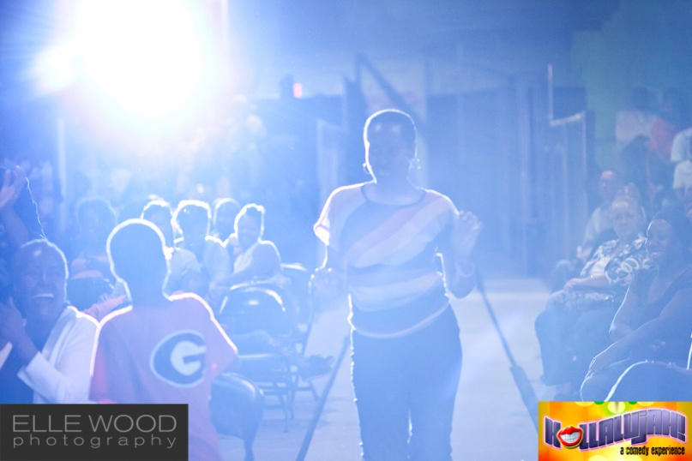
Connect With Us & Let Us Go to Work for Your Brand
Hollalujah Enterprises, Inc.
Phone: (678)612-4322 Sponsorships@Hollalujah.com

